Slide 1

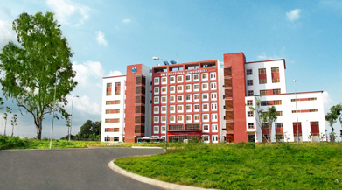
International University
MICRO-PROCESSING SYSTEM
Lecture 0D:
Working of Computer Amination
Vo Minh Thanh, M.Eng
School Of Electrical Engineering

Slide 2
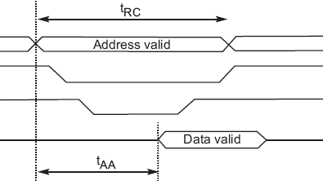
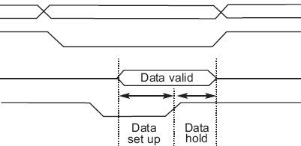
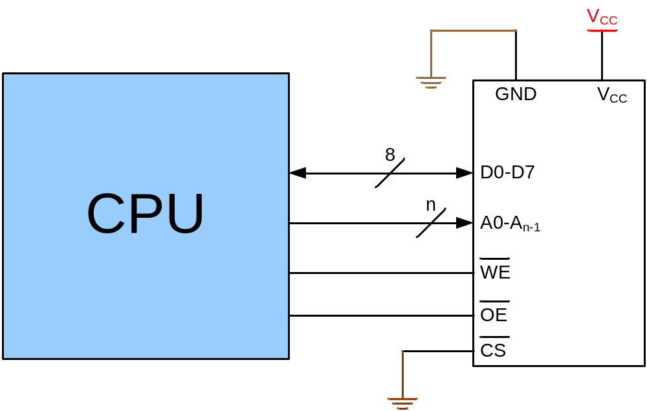
Connecting memory to CPU
Writing to memory
Reading from memory
Address
Address
CS
CS
OE
Data
Data
WE
WE
Time
Time

Slide 3
Connecting I/Os to CPU
CPU should have lots of pins!
Mouse
CPU
Network
Keyboard
Sound Card
Graphic Card

Slide 4
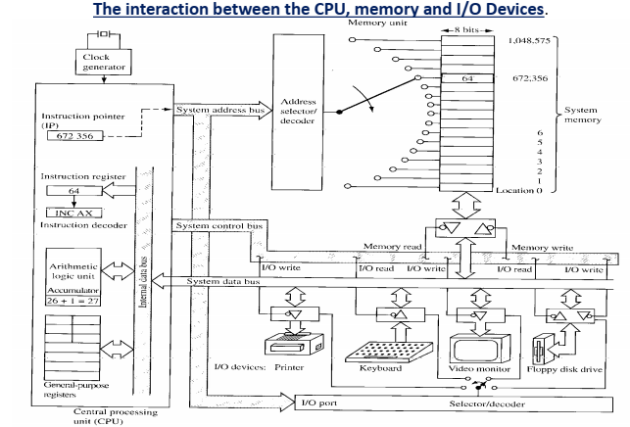
Connecting I/Os to CPU using bus

Slide 5
Connecting I/Os to CPU using bus
CPU
Address bus
Data bus
Control bus
Write
Read
I/O 0
I/O 1
I/O 2
I/O n

Slide 6
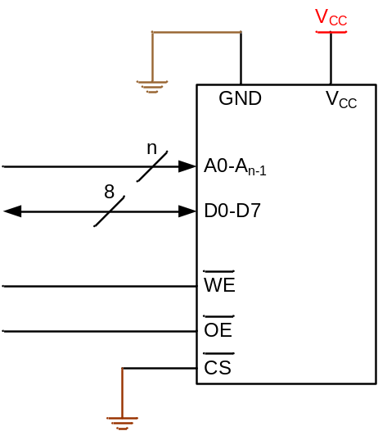
Connecting I/Os and Memory to CPU
CPU
Address bus
Data bus
Control bus
Write
Read
I/O 0
I/O 1
I/O 2
I/O n

Slide 7
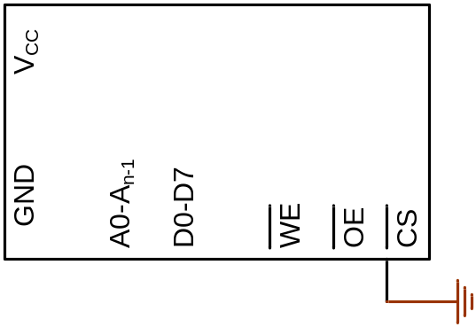
Connecting I/Os and memory to CPU using bus
0
1
2
3
How could we manage it?
CPU
0
Address bus
Data bus
Control bus
Write
Read
I/O 0
I/O 1
I/O 2
I/O n

Slide 8
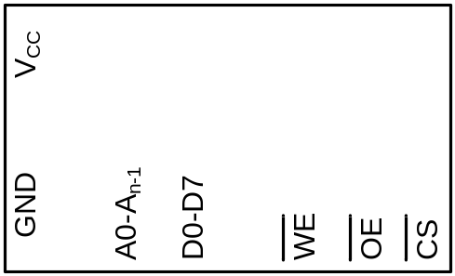
Connecting I/Os and Memory to CPU using bus
(Peripheral I/O)
0
1
..
63
CPU
Address bus
Data bus
Write
Control bus
Read
IO/MEM
I/O 0
I/O 1
I/O 2
I/O n

Slide 9
Inside the CPU
PC (Program Counter)
Instruction decoder
ALU (Arithmetic Logic Unit)
Registers
CPU
ALU
PC
A
B
C
Instruction decoder
D
registers

Slide 10
Operation of a Processor
While (in operation)
Fetch instruction pointed by PC
Increment PC to point to next Instruction
Decode Instruction
Load 1st Operand (if any)
Load 2nd Operand (if any)
Execute Instruction
End While

Slide 11
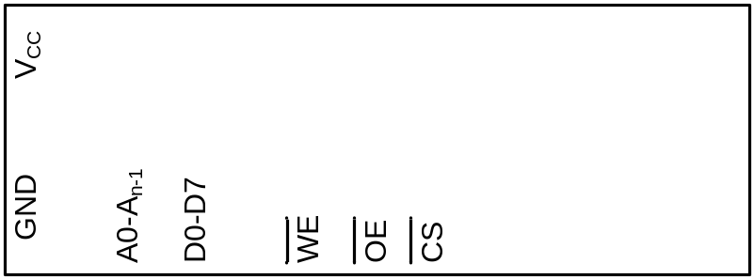
How computers work
31h
C4h
26h
81h
EAh
0h
5h
A← [17]
B ← A
A ← [6]
A←A+B
[7]←A
31
0
1
2
3
4
5
6
7
CPU
Address bus
Logic circuit
Data bus
Control bus
Write
Read
ALU
A
B
PC:
1
C
0
0
D
I/O 16
I/O 17
I/O 18
I/O n
Inst. Dec.
registers

Slide 12
How computers work
31h
C4h
26h
81h
EAh
0h
5h
A← [17]
B ← A
A ← [6]
A←A+B
[7]←A
0
1
2
3
4
5
6
7
CPU
Address bus
17
Logic circuit
Data bus
Control bus
Write
Read
ALU
A
B
PC:
1
C
9
D
I/O 16
I/O 17
I/O 18
I/O n
Inst. Dec.
registers
31

Slide 13
How computers work
31h
C4h
26h
81h
EAh
0h
5h
A← [17]
B ← A
A ← [6]
A←A+B
[7]←A
0
1
2
3
4
5
6
7
C4
26
5
CPU
17
Logic circuit
Address bus
6
Data bus
Control bus
Write
Read
9
ALU
9
A
B
PC:
1
2
2
1
C
3
D
I/O 16
I/O 17
I/O 18
I/O n
Inst. Dec.
registers

Slide 14
How computers work
31h
C4h
26h
81h
EAh
0h
5h
A← [17]
B ← A
A ← [6]
A←A+B
[7]←A
0
1
2
3
4
5
6
7
81
EA
CPU
Address bus
7
Logic circuit
Data bus
Eh
Control bus
Write
Read
E
5
ALU
5
+
A
E
9
9
B
PC:
4
4
3
C
3
5
D
I/O 16
I/O 17
I/O 18
I/O n
Inst. Dec.
registers

Slide 15
How Instruction decoder works
Opcode
Operand
Opcode
Operand
Instruction
Instruction
Operation Code | Meaning
000 | A ← x
001 | A ← [x]
010 | A ← A – register (x)
011 | A ← A + x
100 | A ← A + register (x)
101 | A ← A – x
110 | Register (x_{H}) ← Register (x_{L})
111 | [x] ← A
0011 0001
1100 0100
0010 0110
1000 0001
1110 1010
0000 0000
0000 0101
31h
C4h
26h
81h
EAh
0h
5h
A← [17]
B ← A
A ← [6]
A←A+B
[7]←A
0
1
2
3
4
5
6
7
17 = 10001b

Slide 16
Von Neumann vs. Harvard
Von Neumann Architecture
Fetches instructions and data from a single memory space
Limits operating bandwidth
address
Read/Write
Memory
data
CPU
control
Harvard Architecture
Uses two separate memory spaces for program instructions and data
Improved operating bandwidth
Allows for different bus widths
address
Program
Memory
data
address
CPU
Data
Memory
data
control
Notes:
Alex Milenkovich

Slide 17
Selecting a Microprocessor
Choose the right one for your application
  Primary criteria: Cost, Power, Size, Speed
  Others: package options, integrated peripherals, potential for future growth
Choose one with good software development support
  development environment - good compiler and debugger availability
  evaluation boards
  in-circuit emulators for those with deep pockets
  Operating system availability
Other considerations
  Code density: affects power consumption, performance and system cost
  Hardware availability: make sure you can actually purchase the microcontroller before designing it in
  Prior expertise, licensing, etc
Notes:
1-<number>

Slide 18
Summary
Microprocessors and embedded controllers are a ubiquitous part of life today
Concept of a microprocessor & microcontroller
Understand how a µP works
Headhunters report that EEs familiar with µC, µP design are in the highest possible demand
Web Resources:
  How Microprocessors Work:
    http://computer.howstuffworks.com/microprocessor.htm
    http://www.intel.com/education/mpworks/
    http://www.cse.psu.edu/~cg471/03f/hw/pj5/how-micro.html
  Great Microprocessors of the Past and Present:
    http://www.sasktelwebsite.net/jbayko/cpu.html
  Great Moments in Microprocessor History:
    http://www-128.ibm.com/developerworks/library/pa-microhist.html
Notes:
1-<number>

